Slide 1
Power BI AI

Slide 2



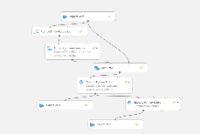
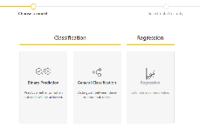
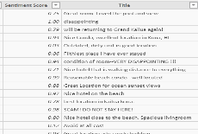
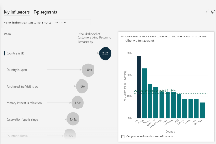
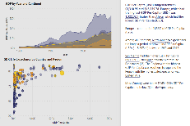
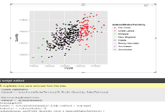
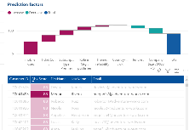
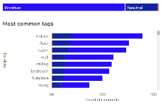
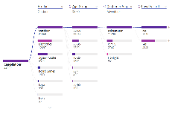
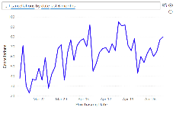

AI in Power BI
Data Scientists
Analysts
Business Users
Create ML models
Sentiment Analysis
Extend with Azure ML
Sentiment Analysis
Key Driver Analysis
Smart Narratives
Python & R Integration
Explore predictions
Key Phrase Extraction
Root Cause Analysis
Q&A

Slide 3
AI for Business Users

Slide 4
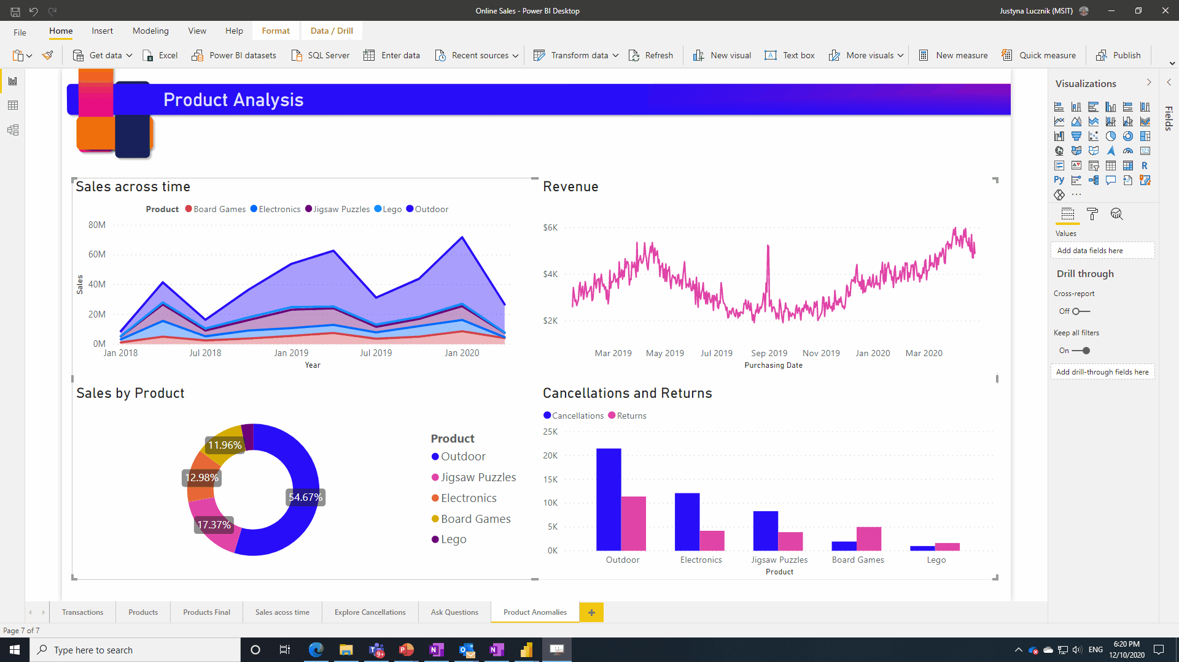
Anomaly Detection
Enrich your time series charts with anomaly detection as well as out of the box explanations for anomalies

Slide 5
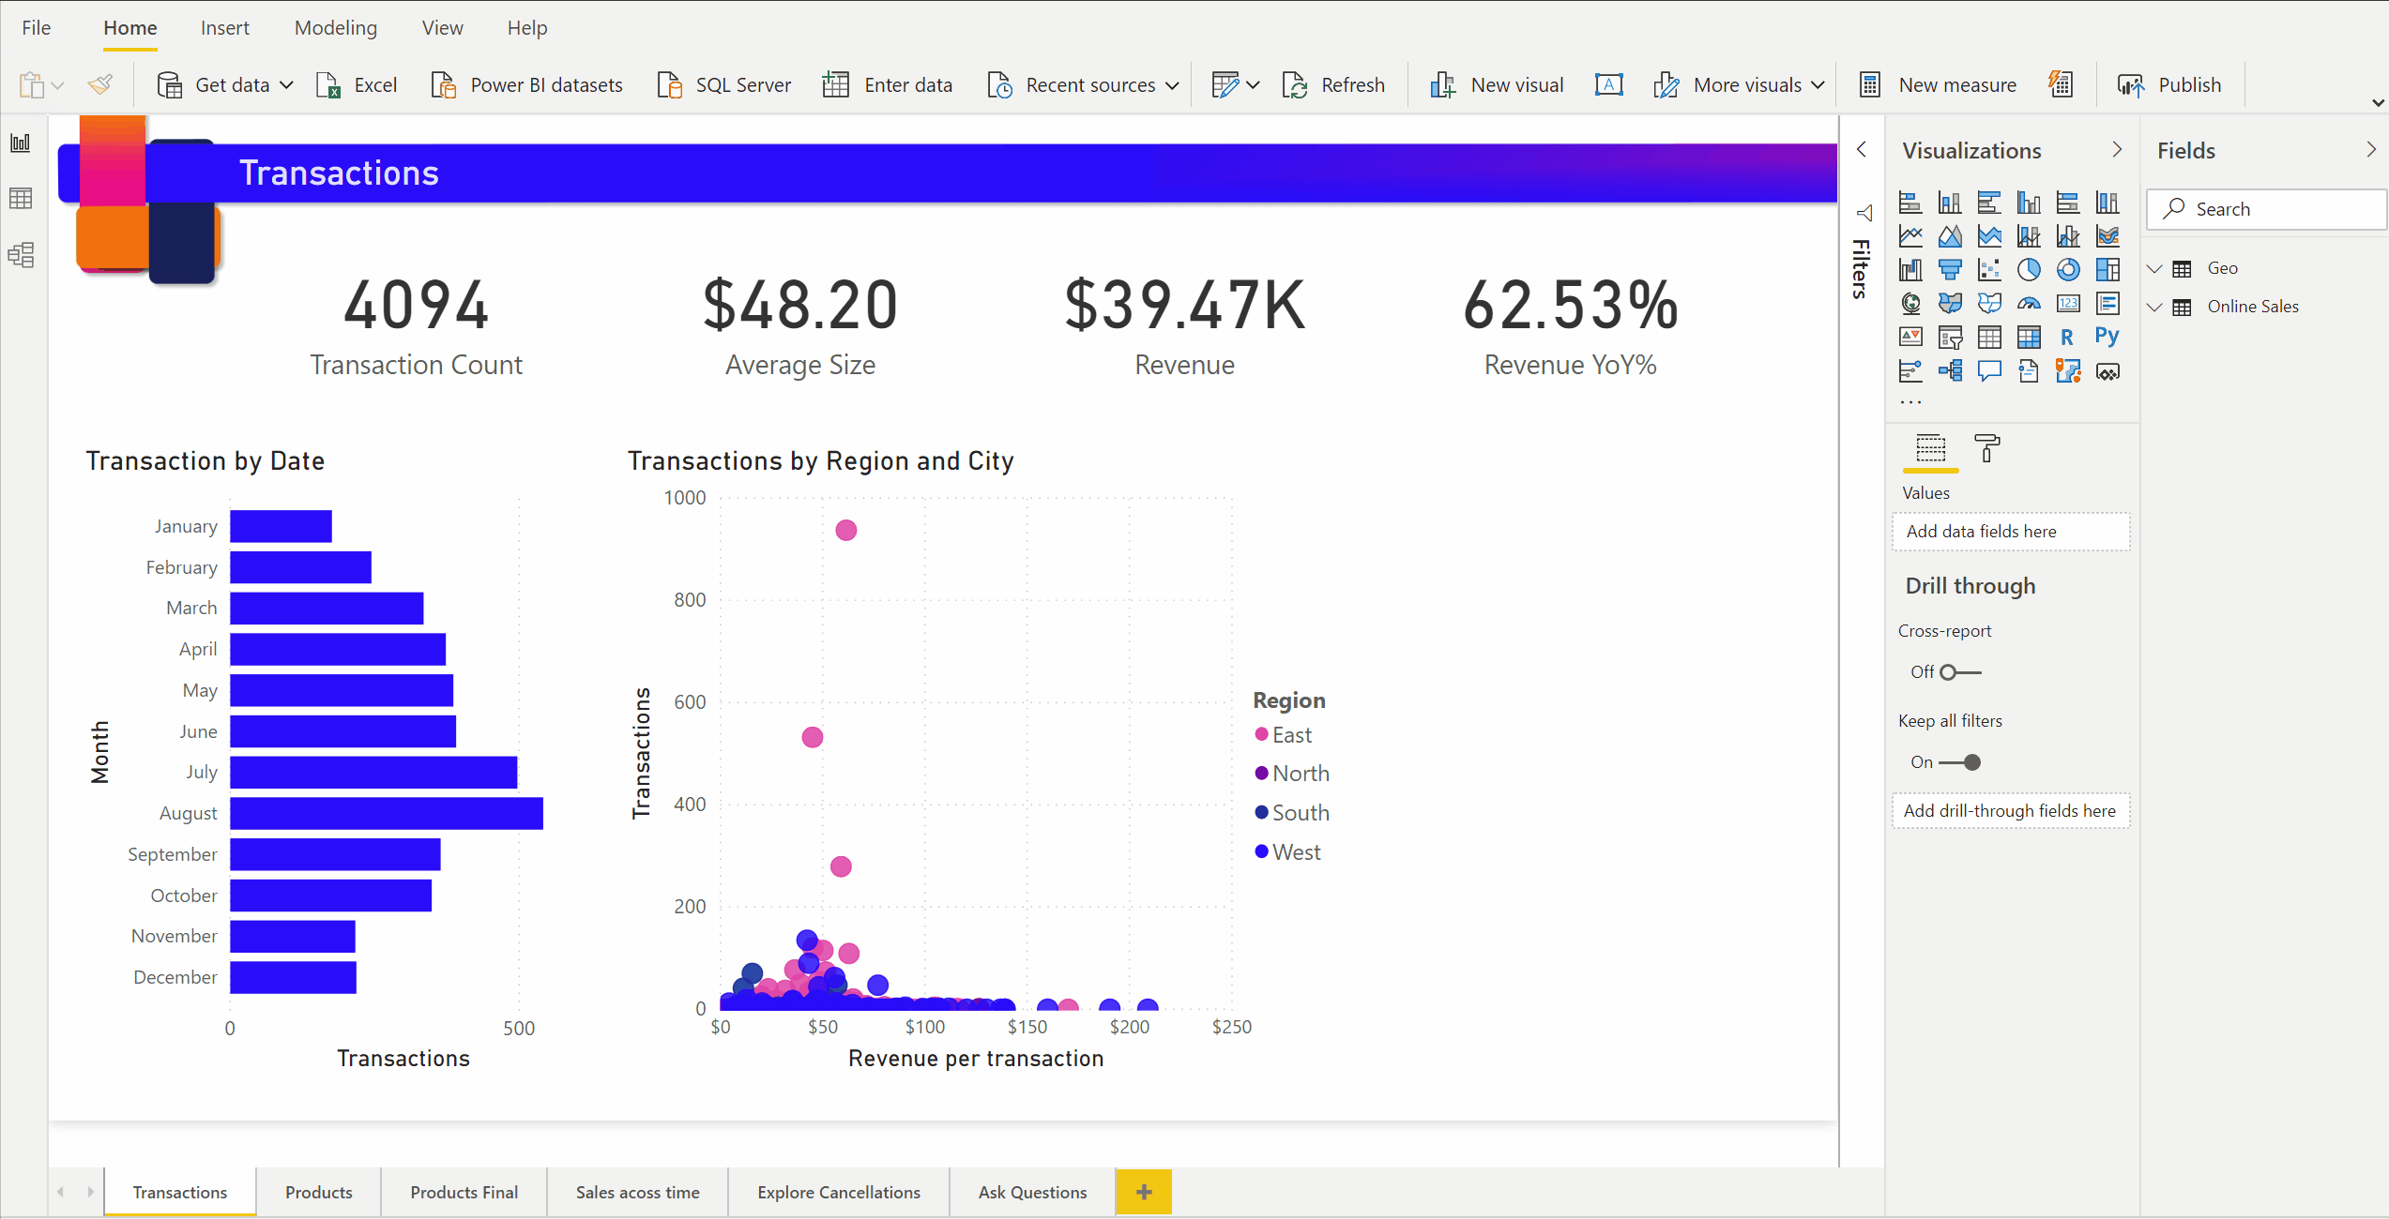
Smart Narrative
Users can automatically summarize insights in their data with natural language. This can be done on a visual level or a report page level.

Slide 6
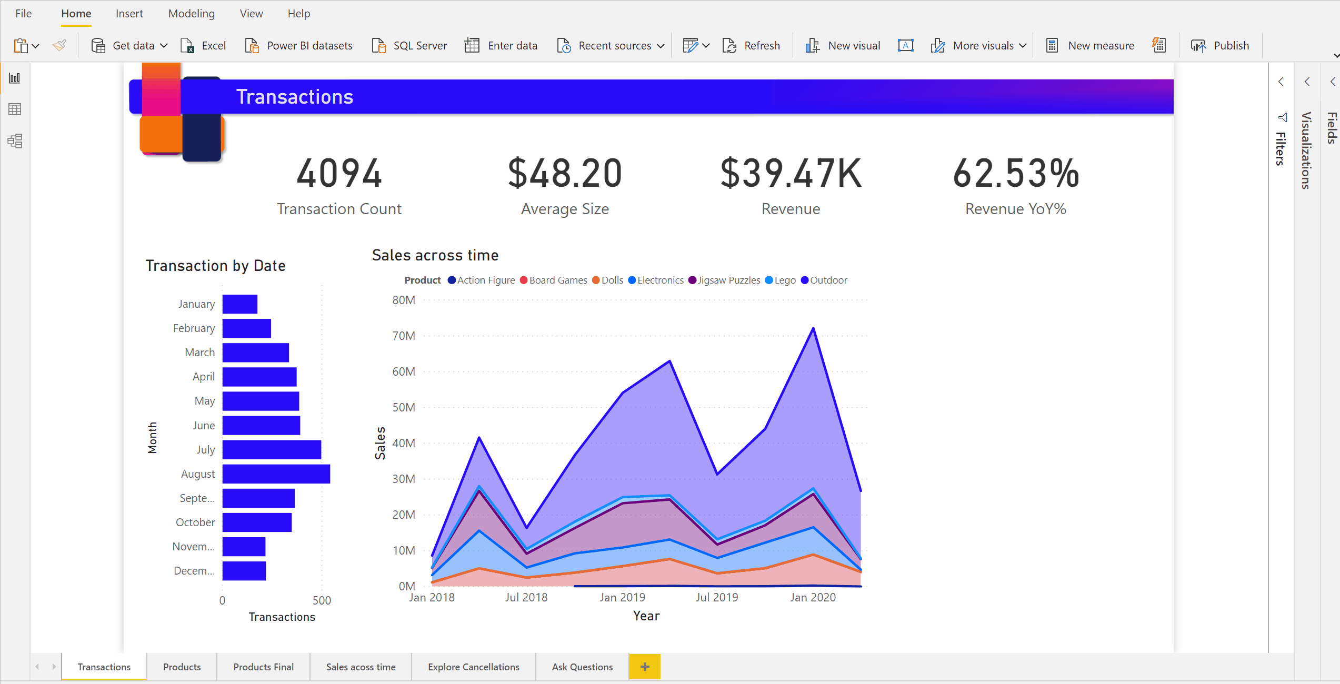
Smart Narrative
Users can format their narratives, changing colors, size and font. Users can add their own dynamic values to the narratives, authoring them via Q&A
.

Slide 7
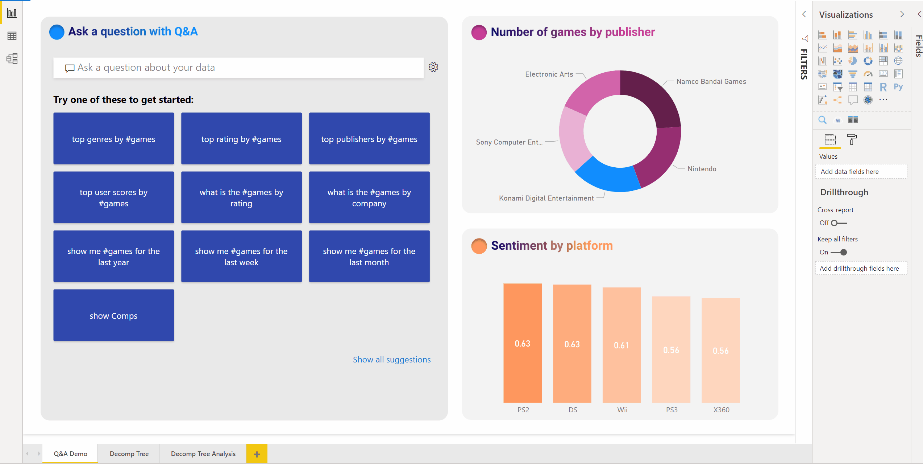
Q&A
Get answers by simply asking natural language questions. The Q&A experience is fully integrated into the report canvas
.

Slide 8
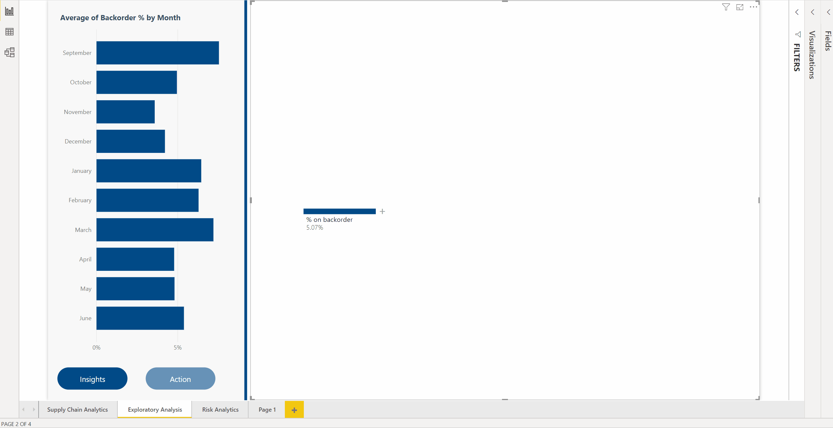
Decomposition Tree
Explore your data via an interactive tree, break down your KPIs and conduct an AI driven root cause analysis
.

Slide 9
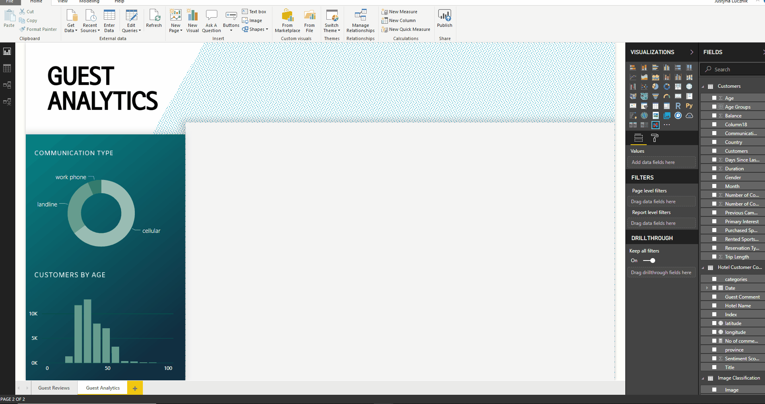
Key Influencers
Author an AI visual to help find what drives your KPIs. Find out what drives your KPIs – Key Influencers uncovers what matters
.

